Slide 1
IBM University Engagement Project Submission
“Exploring the Power of Agentic AI with IBM Granite and LangFlow”

Slide 2

Project Title – Social Media Agent
Domain of Project – Artificial Intelligence (AI) & Social Media Analytics
Student Name | Recent Passport Photo | Email ID | Mobile number [WhatsApp]
Tanish Chogale |  | tanishchogale@gmail.com | 8625044103

Slide 3
Problem Statement- Social Media Agent
The Challenge
Brands, influencers, and organizations struggle to keep up with the fast-paced and fragmented world of social media. Content trends evolve hourly, audience sentiment shifts rapidly, and competitor strategies are difficult to track. Managing multiple platforms often leads to scattered insights, missed engagement opportunities, and ineffective campaigns. The challenge is not only to collect social media data but also to analyze, predict, and recommend actions in real time
The Objective
Build an agentic AI application that acts as an intelligent social media companion.
The solution should:
Fuse Multichannel Data :- Collect and synthesize content, comments, hashtags, and competitor posts from platforms like X, LinkedIn, Instagram, and Facebook into unified insights.
Enable Multimodal Interaction :- Accept user inputs (text, images, or voice prompts) and generate creative post drafts, captions, or campaign ideas aligned with brand tone.
Create a Predictive & Agentic Layer :- Forecast trending hashtags, audience sentiment shifts, and competitor engagement patterns while suggesting the best posting schedules.
Visualize Social Media Pulse :- Provide a dashboard with real-time analytics—engagement trends, influencer mapping, sentiment tracking, and campaign performance forecasts.
Tech Stack (Mandatory)
IBM Langflow / IBM Orchestrate + IBM Models

Slide 4
Proposed Solution
SocialSense AI is an intelligent, agentic social media assistant that helps brands, influencers, and organizations streamline their social media management using AI.
The platform integrates data from multiple social media channels, analyzes audience engagement and sentiment, tracks competitor activities, identifies trending topics and hashtags, and generates platform-specific content tailored to the user's brand voice.
Built on IBM watsonx.ai, IBM Langflow, and IBM Orchestrate, SocialSense AI employs a multi-agent architecture where specialized AI agents collaborate to collect data, generate content, analyze trends, predict engagement, and provide actionable recommendations.
A Retrieval-Augmented Generation (RAG) layer enables the system to retrieve relevant brand guidelines, previous campaigns, and marketing documents, ensuring personalized and context-aware responses.
The solution features an interactive dashboard that provides real-time analytics, campaign performance metrics, audience sentiment, competitor comparisons, trending hashtags, and optimal posting schedules.
By combining generative AI, predictive analytics, and intelligent automation, SocialSense AI empowers users to create high-quality content, make data-driven marketing decisions, and maximize audience engagement while significantly reducing manual effort.

Slide 5
Technologies Used
IBM watsonx.ai – Powers AI-driven content generation and intelligent insights.
IBM Langflow – Designs and manages multi-agent AI workflows visually.
IBM Orchestrate – Coordinates AI agents to automate end-to-end tasks.
Python (Flask/FastAPI) – Handles backend logic and API integration.
HTML, CSS & JavaScript – Build a responsive and interactive user interface.
ChromaDB (RAG) – Stores and retrieves contextual knowledge for AI responses.
Chart.js – Visualizes analytics, trends, and engagement metrics.
IBM Cloud – Hosts, deploys, and scales the application.
Social Media APIs – Fetch real-time posts, trends, and engagement data from social platforms.

Slide 6
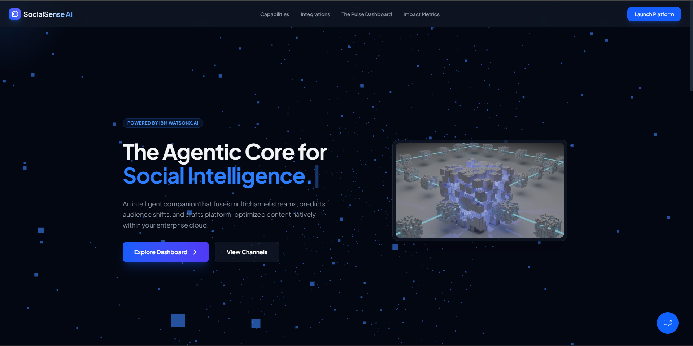
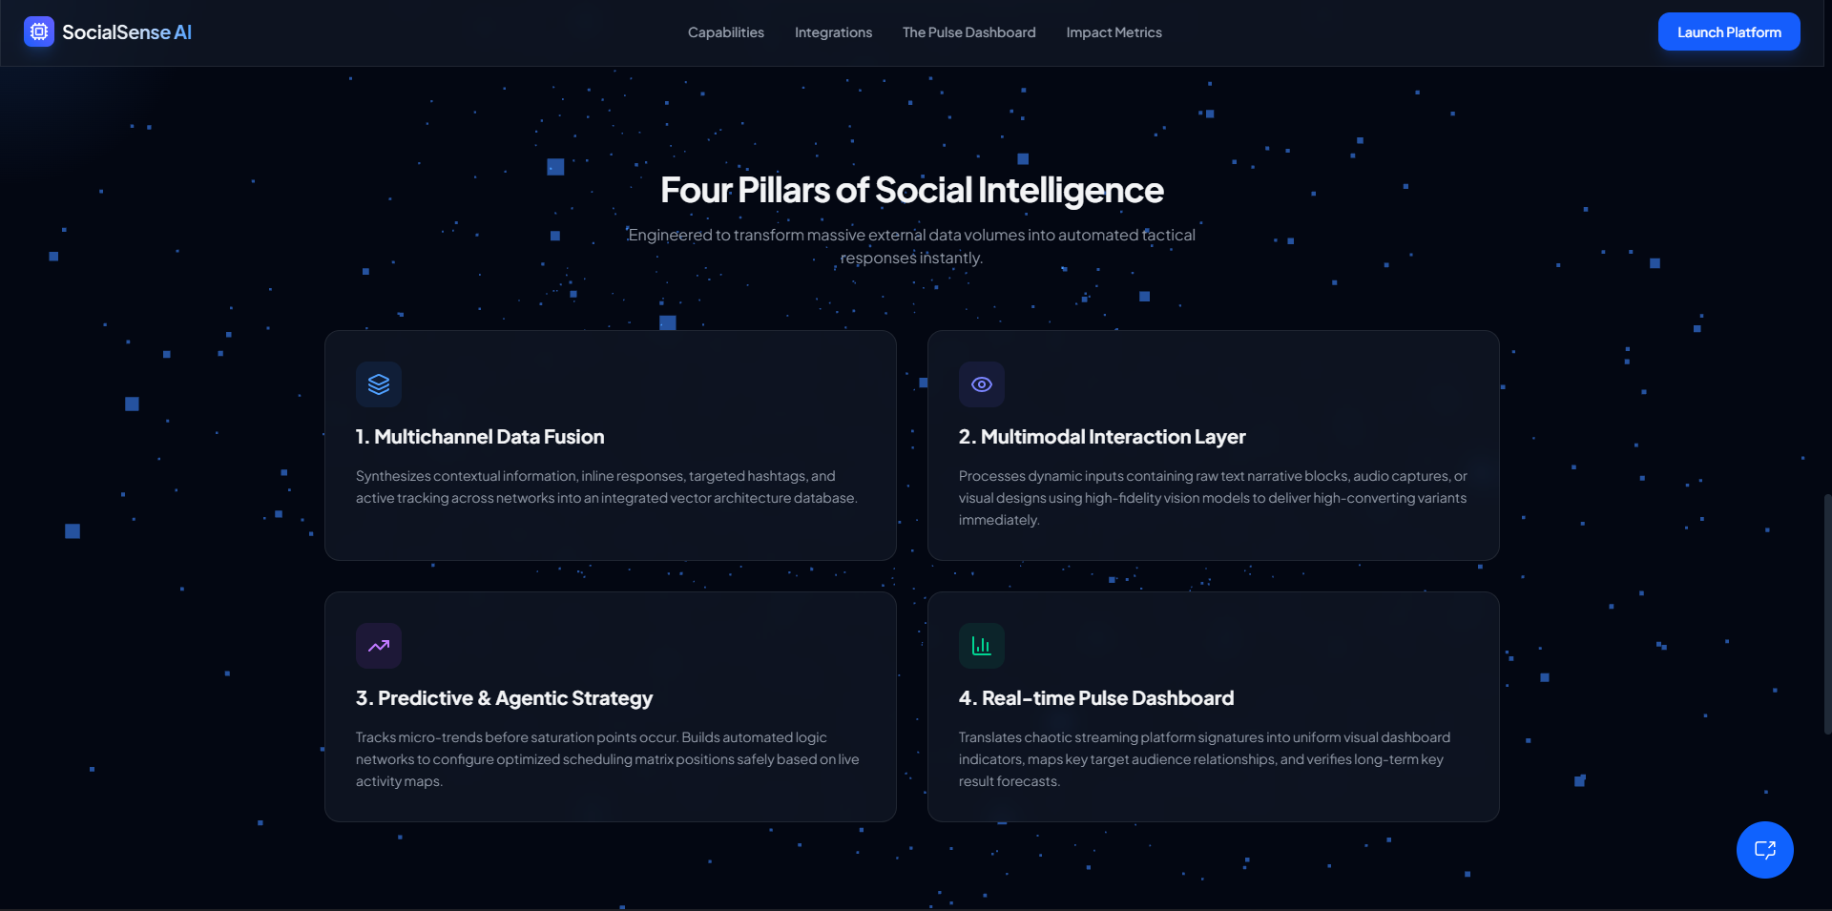
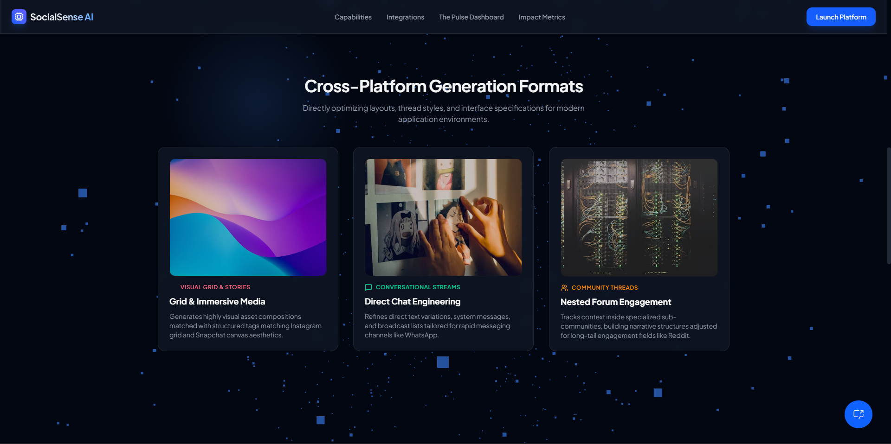
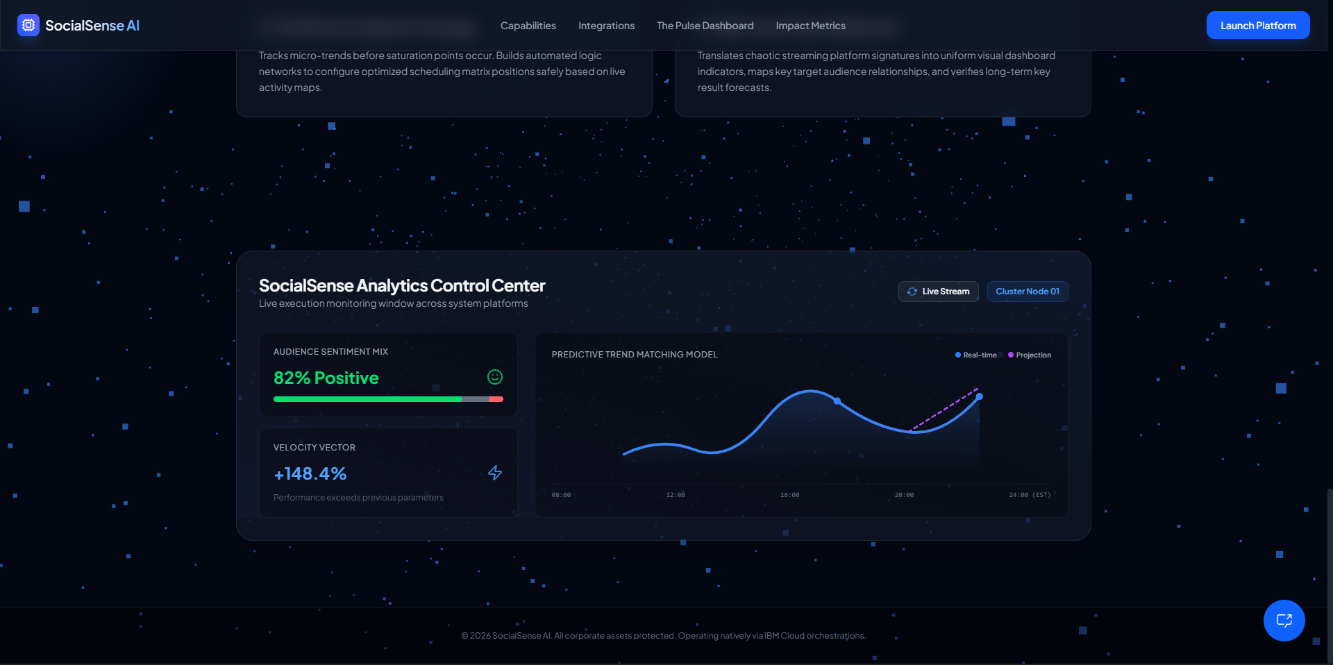

Slide 7
Langflow component Used -
Chat Input – Receives user queries.
Prompt Template – Structures AI prompts.
IBM Granite Model – Generates AI responses.
Agent – Performs specialized AI tasks.
HTTP Request – Connects to social media APIs.
Retriever (RAG) – Fetches relevant knowledge.
Memory – Maintains conversation context.
Chat Output – Displays the final response.

Slide 8
Role of Agentic AI in the Solution
Agentic AI enables SocialSense AI to autonomously perform specialized tasks through multiple intelligent agents that collaborate to achieve a common goal. Each agent is responsible for a specific function, such as collecting social media data, analyzing trends, generating content, monitoring competitors, and predicting engagement. The agents communicate through an orchestrator, allowing the system to make context-aware decisions, automate workflows, and provide actionable recommendations with minimal user intervention.

Slide 9
Novelty & Uniqueness
Multi-Agent AI Architecture: Uses specialized AI agents for content generation, trend analysis, sentiment analysis, competitor monitoring, and campaign recommendations.
Unified Social Intelligence: Combines data from multiple social media platforms into a single dashboard for comprehensive insights.
Predictive Analytics: Forecasts trending hashtags, audience engagement, and optimal posting schedules using AI.
Brand-Aware Content Generation: Generates personalized, platform-specific content that aligns with the user's brand voice.
IBM Agentic AI Powered: Leverages IBM watsonx.ai, IBM Orchestrate, and Langflow to deliver an intelligent, automated social media assistant.

Slide 10
Future Scope
Support more social media platforms such as YouTube, TikTok, and Threads.
AI-generated images and videos for marketing campaigns.
Real-time campaign automation with automatic scheduling and publishing.
Multilingual content generation to reach global audiences.
Influencer discovery and collaboration recommendations using AI.
Advanced predictive analytics for campaign ROI and audience growth.
Voice-enabled AI assistant for hands-free social media management.
CRM and marketing tool integration (Salesforce, HubSpot, etc.) for end-to-end campaign management.

Slide 11
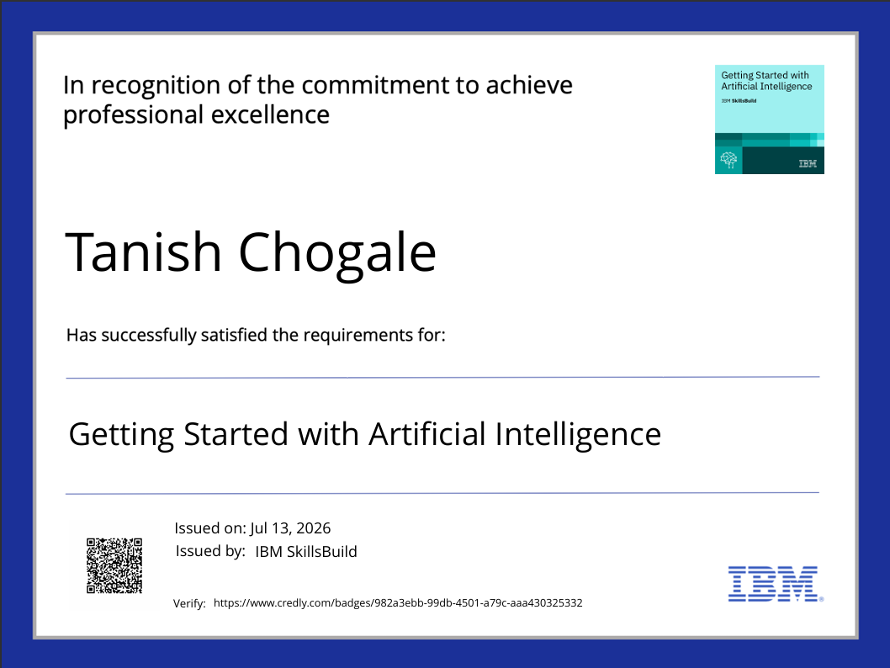
Certificates Earned

Slide 12
Github Link
https://github.com/Tanish0607/Social-Sense-AI
File name- SOCIAL.html

Slide 13
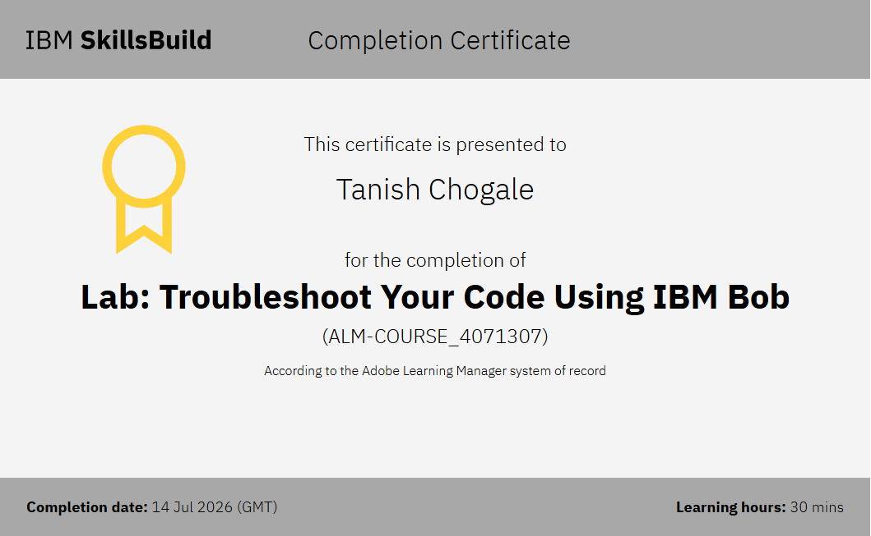
Certificates Earned

Slide 14
THANK YOU

